Slide 1

NATIONAL ROCKETRY CHAMPIONSHIP
Flight Readiness Review
<TEAM EXODUS >
<Parshva Patel (Avionics Lead) >

Slide 2
FRR Guidance [To be deleted]
Please refer to the FRR Guidance Document NRC-FRG-001
before filling in your FRR
General comments:
You may use as many slides as you need for each section
The sections in this template are mandatory, you may add other critical flight task sections if you wish
Guidance is given by UKSEDS in each section
The FRR should be submitted as a google slides/powerpoint presentation. You do not need to present it
The FRR is not marked, it is pass/fail

Slide 3
Overview
Task | Status | Comments
Requirement Compliance | Complete | Most requirements met. Two test yet to be completed.
Launch Vehicle Manufacture | Complete | Cutouts for external excess marked but cutting pending. New nosecone to print.
OpenRocket Simulation | Complete
Recovery System Assembly | Complete
Recovery System Demonstration | Complete
Structural Tests | Complete

Slide 4
Overview
Task | Status | Comments
Launch Vehicle Decoration | Incomplete
Rideshare Payload Manufacture | Complete
Rideshare Payload Code | Incomplete
Rideshare Payload Tests | Complete
The Customer’s Payload | Complete
Competition Day Procedure | Complete

Slide 5
Requirement Compliance - [To be deleted]
The following slides contain all of UKSEDS’ 2025 NRC requirements and the revisions are correct as of the creation of this template
In order to pass your FRR, you are expected to have met all of these requirements
It is important that you have verified the requirements with their correct V&V method. Eg. if you have a structural requirement that says a fin shall not deflect more than X mm and the V&V method is test. You cannot say that the rationale of meeting this requirement is that you have carried out FEA on it as that is the analysis V&V method, not test as the requirement specified.
It may not be possible to meet all of the requirements in some cases as some may conflict. Therefore, if you have not met a requirement, please explain what steps you have taken to attempt to meet it and why you were unable to.

Slide 6
Requirement Compliance
Requirement ID | Met? [Yes, No, Partially] | Rational
NRC MRD-MIS-001 | Rev: A | Partially | Openrocket shows 1660 feet
NRC MRD-MIS-002 | Rev: A | Yes | Openrocket shows 1660 feet
NRC MRD-MIS-003 | Rev: A | Yes | Openrocket shows 1660 feet
NRC MRD-MIS-004 | Rev: A NRC MRD-MIS-005 | Rev: A NRC MRD-MIS-006 | Rev: A | Yes | The order is placed for Ceseroni Technology Pro-29mm [108G68-13A-9] from UKSEDS’ NRC organising team.
NRC MRD-MIS-007 | Rev: A | Yes | RPD weighs 160 grams

Slide 7
Requirement Compliance
Requirement ID | Met? [Yes, No, Partially] | Rational
NRC MRD-CPD-001 | Rev: B | Yes | CPD is powered with 3.3-4.7V Li-ion battery
NRC MRD-CPD-002 | Rev: A | Yes | CPD powered by a 2000mAh > 1523 mAh required. (battery not shared with RPD)
NRC MRD-CPD-003 | Rev: A | Yes | Battery has a discharge rate greater than 2.03C supplying 7.5w minimum for 45 min
NRC MRD-CPD-004 | Rev: B | Yes | Female XT30 provided by participants
NRC MRD-CPD-005 | Rev: A | Yes | 16gb microsd provided
NRC MRD-CPD-006 | Rev: B | Yes | Adapter printed and tested
NRC MRD-CPD-007 | Rev: B | Yes | Required space provided and tested with dummy payload

Slide 8
Requirement Compliance
Requirement ID | Met? [Yes, No, Partially] | Rational
NRC MRD-CPD-008 | Rev: B | Yes | Motor and payload paced in the centre
NRC MRD-CPD-009 | Rev: B | Yes | External cutout provided
NRC MRD-CPD-010 | Rev: A | Yes | All sections have cutouts for depressurisation
NRC MRD-CPD-011 | Rev: A | Yes | M3 bolts provided by the team
NRC MRD-RPD-001 | Rev: A | Yes | Custom designed PCB used for avionics
NRC MRD-RPD-002 | Rev: A | Yes | Barometer used for altitude
NRC MRD-RPD-003 | Rev: A | Yes | Altitude time plotted on an SD card

Slide 9
Requirement Compliance
Requirement ID | Met? [Yes, No, Partially] | Rational
NRC MRD-RPD-004 | Rev: A | Partially | Single led would loop blinks of 1s & 0s which can be deciphered to get altitude
NRC MRD-RPD-005 | Rev: A | Yes | Team Logo on silkscreen
NRC MRD-RPD-006 | Rev: A | Yes | IMU, GPS data collected and stored on sd card
NRC TSN-MOR-001 | Rev: A | Yes | Mount epoxied at the front and midway motor mounted using clamped retainer
NRC TSN-MOR-002 | Rev: A | Yes
NRC TSN-MOR-003 | Rev: A | Yes
NRC TSN-SMN-001 | Rev: A | Partially | OpenRocket shows 17.2m/s, I got guidance from UKSEDS that if stability are in specs I am fine.

Slide 10
Requirement Compliance
Requirement ID | Met? [Yes, No, Partially] | Rational
NRC TSN-SMN-003 | Rev: A | Yes | Stability margin within range
NRC TSN-SAR-001 | Rev: A | Yes | Alignment in spec
NRC TSN-SAR-002 | Rev: A | Yes | Load is 2 x 0.0445kg x 85 (m/s^2) = 7.6N = 800g of load successfully sustained.
NRC TSN-SAR-003 | Rev: A
NRC TSN-SAR-004 | Rev: A | No | The nose cone broke before this testing hence. I am looking for extension to submit this test before 30th if possible.
NRC TSN-SAR-005 | Rev: A | Yes | Body tube diameter is 54.4 mm coupler tube is 60mm on each side
NRC TSN-SAR-006 | Rev: A

Slide 11
Requirement Compliance
Requirement ID | Met? [Yes, No, Partially] | Rational
NRC TSN-SAR-007 | Rev: A | Yes | Rocket has two rail buttons placed at the recommended location
NRC TSN-SAR-008 | Rev: A | Yes | Actual loads have been applied no FEA used
NRC TSN-ESS-001 | Rev: A | Yes | It ran for 2hrs > required 15 min
NRC TSN-ESS-002 | Rev: A | Yes | Armed in 3 min
NRC TSN-ESS-003 | Rev: A | Yes | Multi core wire is used
NRC TSN-ESS-004 | Rev: A | Yes | 433 MHz used
NRC TSN-RRS-001 | Rev: A | Yes | Parachute is the recovery system

Slide 12
Requirement Compliance
Requirement ID | Met? [Yes, No, Partially] | Rational
NRC TSN-RRS-002 | Rev: A | Yes | OpenRocket shows 10m/s
NRC TSN-RRS-003 | Rev: A | Yes | OpenRocket shows max displacement = 600m
NRC TSN-RRS-004 | Rev: A | Yes | No flight computer used
NRC TSN-RRS-005 | Rev: A | Yes | No recovery circuit used
NRC TSN-RRS-006 | Rev: A | Yes | No tilt switches used
NRC TSN-RRS-007 | Rev: A | Yes | No flight computer used
NRC TSN-RRS-008 | Rev: A | Yes | Bolted Eye nuts used for attachment

Slide 13
Requirement Compliance
Requirement ID | Met? [Yes, No, Partially] | Rational
NRC TSN-RRS-007 | Rev: A | Yes | 3m length is used
NRC TSN-RRS-008 | Rev: A | Yes | Kevlar cord is used
NRC TSN-ARY-001 | Rev: A | Yes | No alternate recovery used
NRC TSN-ARY-002 | Rev: A | Yes | No alternate recovery used
NRC TSN-ARY-003 | Rev: A | Yes | No alternate recovery used

Slide 14
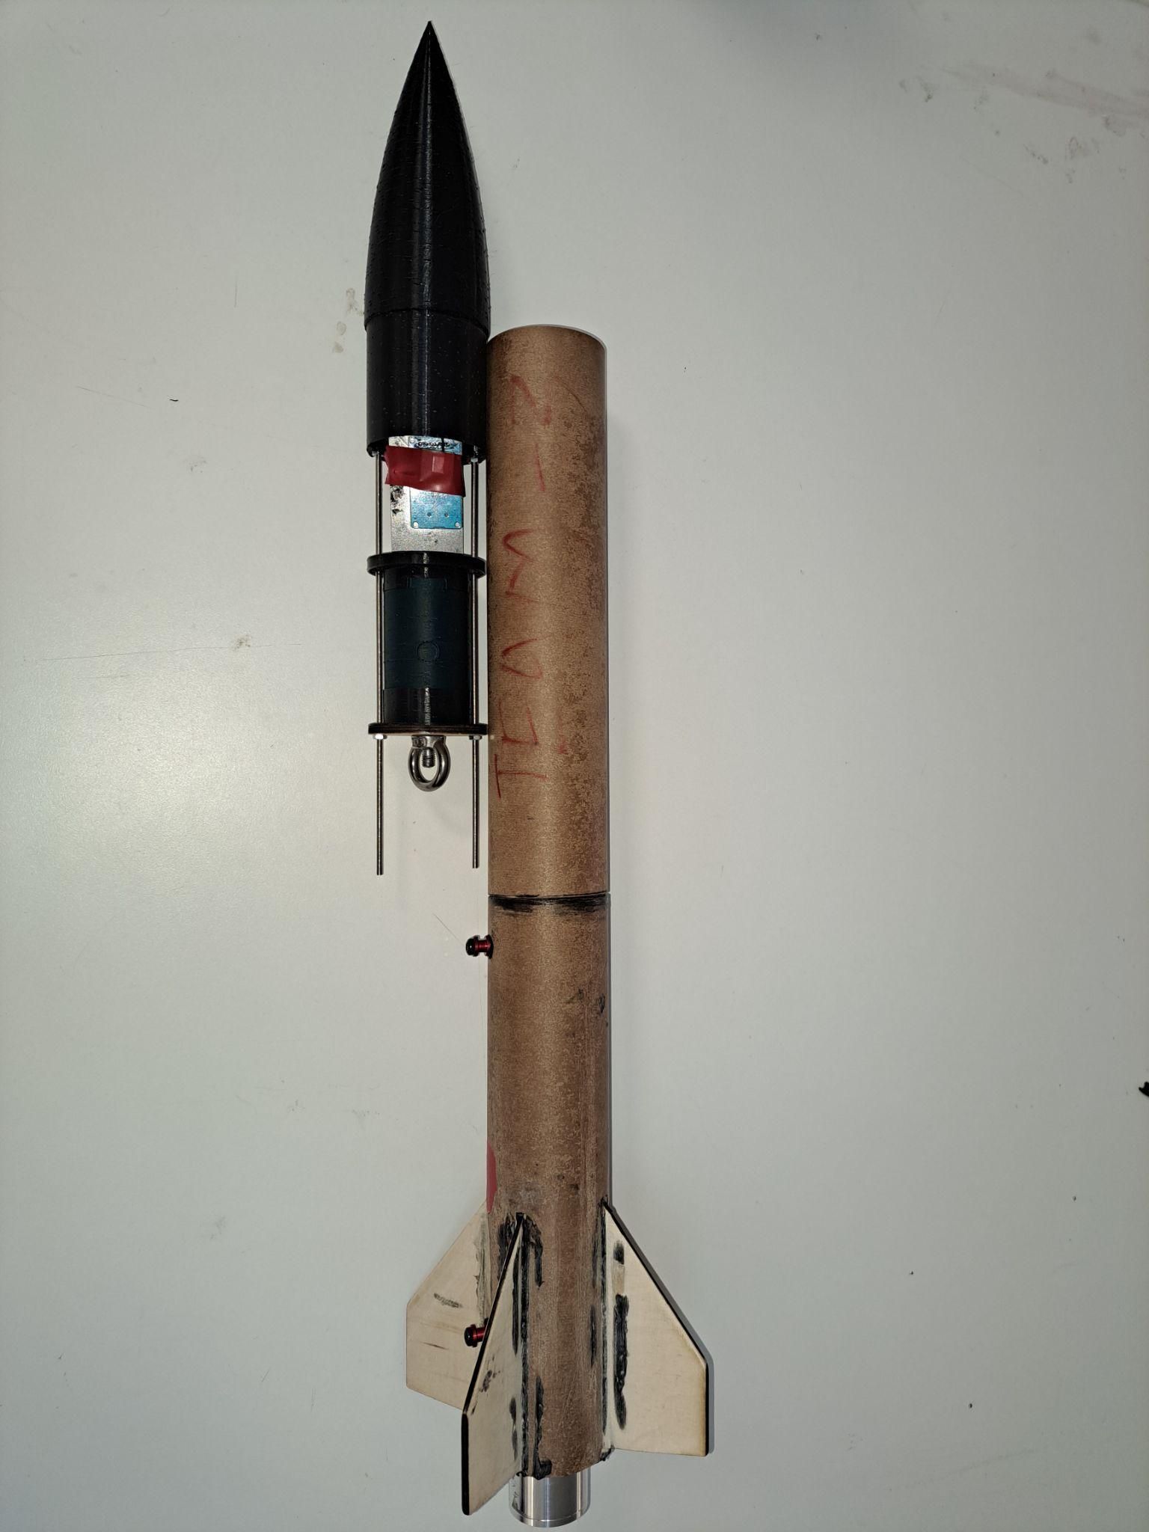
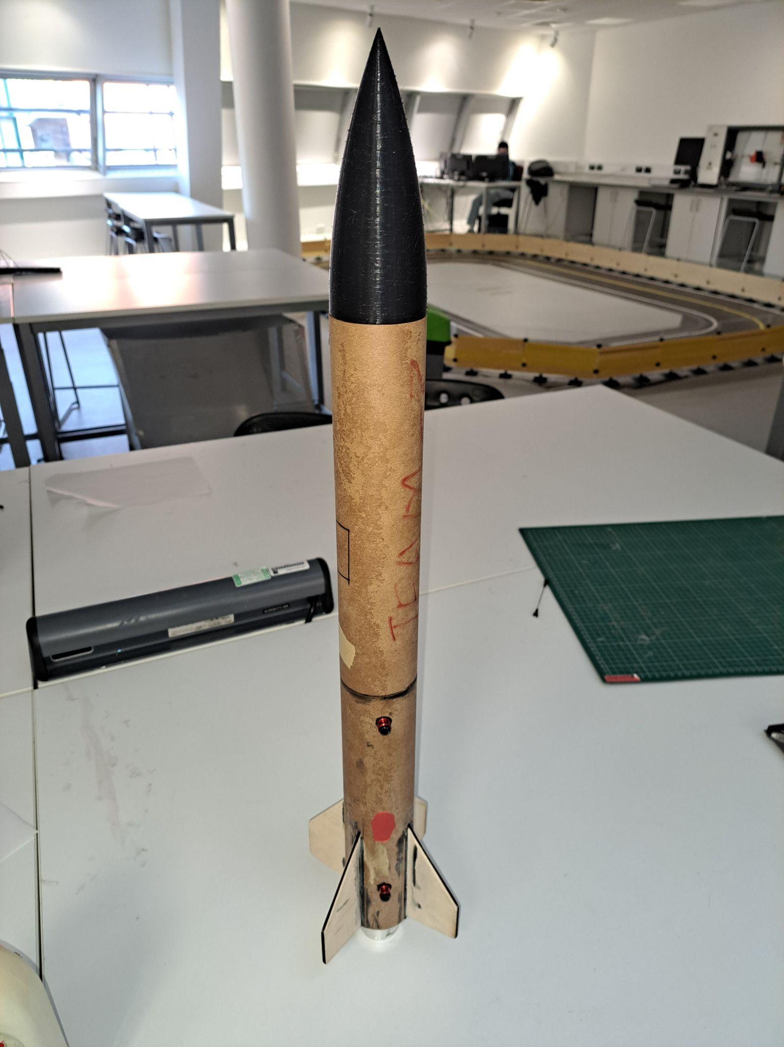
Launch Vehicle Manufacture

Slide 15
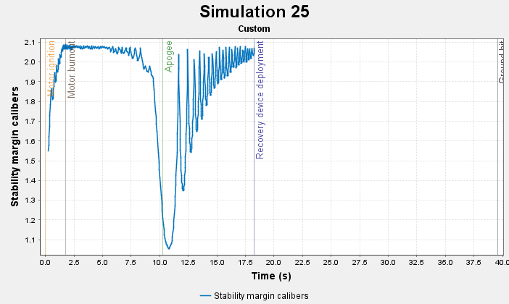
OpenRocket Simulation
Examples of what to include:
Stability vs time plot for a 2m rail
Side by side view of labelled OpenRocket mass distribution and completed rocket to show evidence of accuracy of OpenRocket simulation

Slide 16
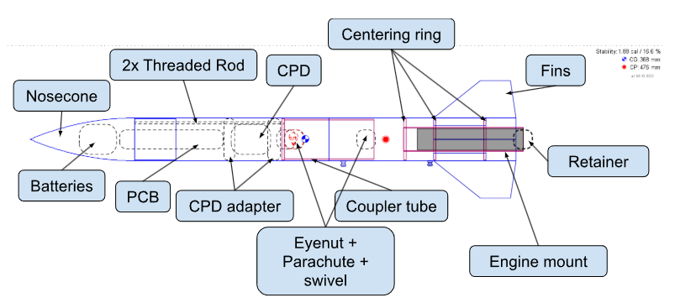
OpenRocket Simulation

Slide 17
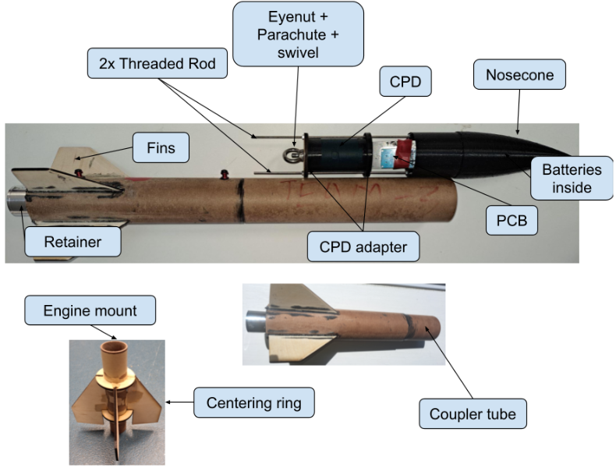
OpenRocket Simulation

Slide 18
OpenRocket Simulation - mass verification
Component | Open Rocket Mass(g) | Actual mass(g)
Fins | 44.5 | 44.5
Batteries | 78 | 2x34+10=78
Retainer | 24 | 24
Threaded Rod | 11
Eyenut v1 | 60 | 62
Eyenut v2 | 22.6 | 22.6

Slide 19
OpenRocket Simulation - mass verification
Component | Open Rocket Mass(g) | Actual mass(g)
Coupler tube | 30g | 30.4g
Upper body tube | 68.6 | 68.6
Lower body tube | 68.7 | 68.7
CPD adapter 1 | 14 | 14
CPD lower adapter | 4 | 5
Nosecone | 107 | 111

Slide 20
OpenRocket Simulation - mass verification
Component | Open Rocket Mass(g) | Actual mass(g)
CPD dummy | 75 | 73
RDP | 37.9 | 37.9
Epoxy + bolts | 8X4 + 1X8 | 40
Parachute | 10g | 11g
Kevlar cord | 10g (cord mass simulated under parachute) | 7g

Slide 21
OpenRocket Simulation - mass verification
Note: Due to some components being epoxied to other components combined with lack of weigh scale. I am unable to provide all of the verification images. However, all of the mass values on open rocket were updated and then simulated to provide accurate value. Mass of rail guides and paint job is not considered!

Slide 22
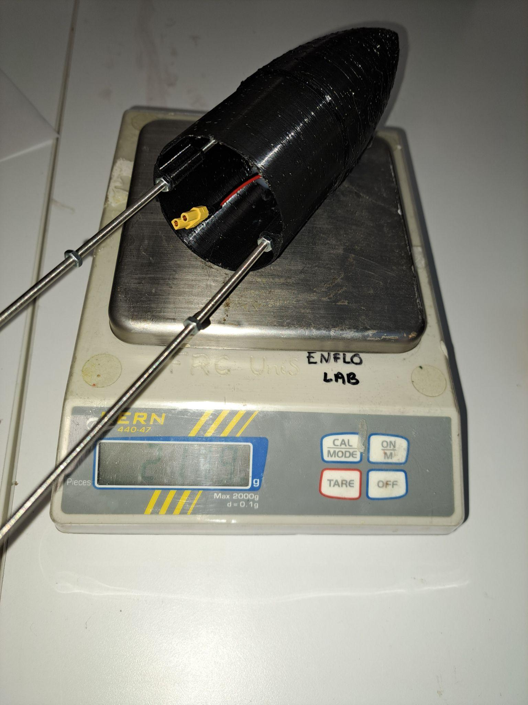
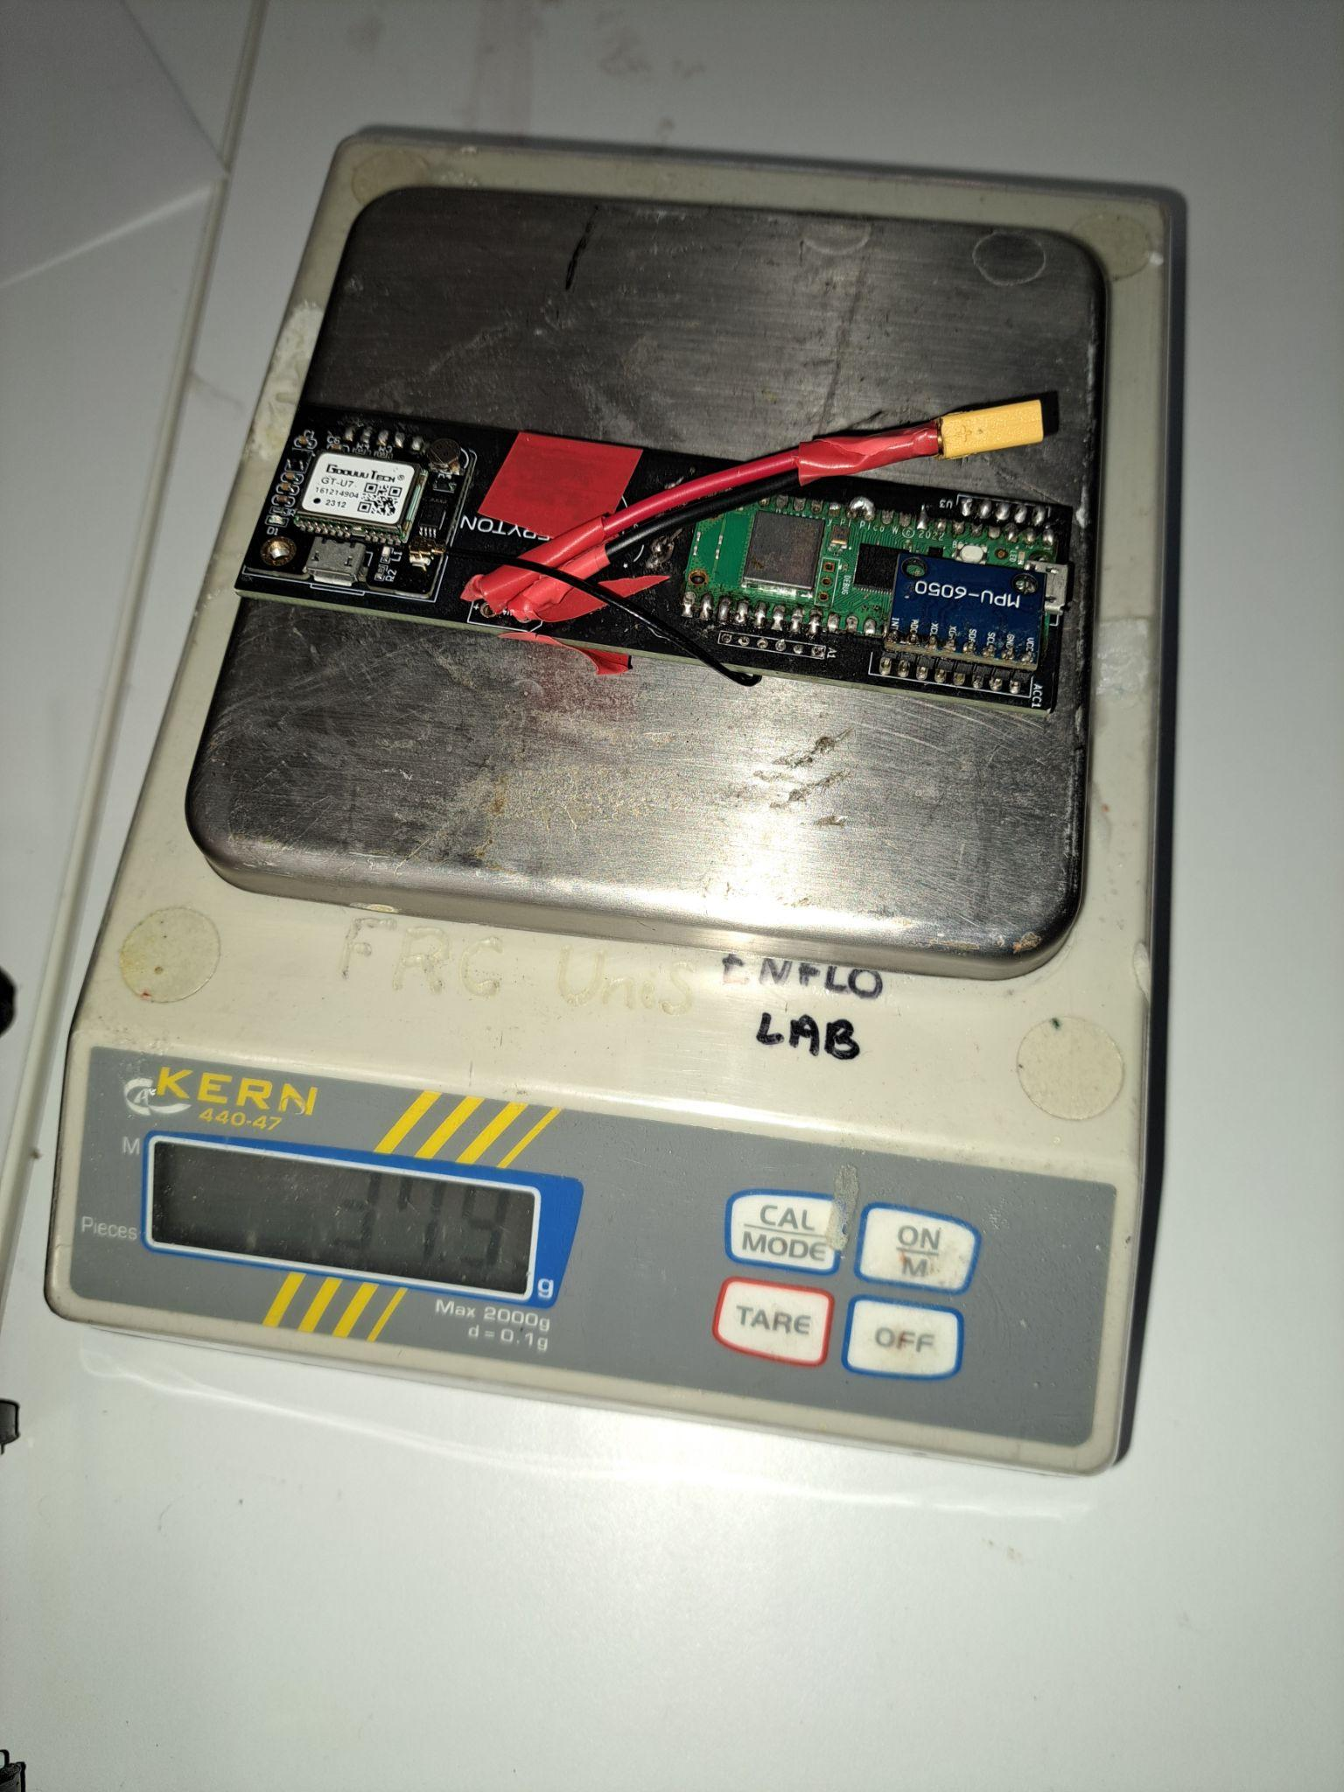
OpenRocket Simulation - mass verification

Slide 23
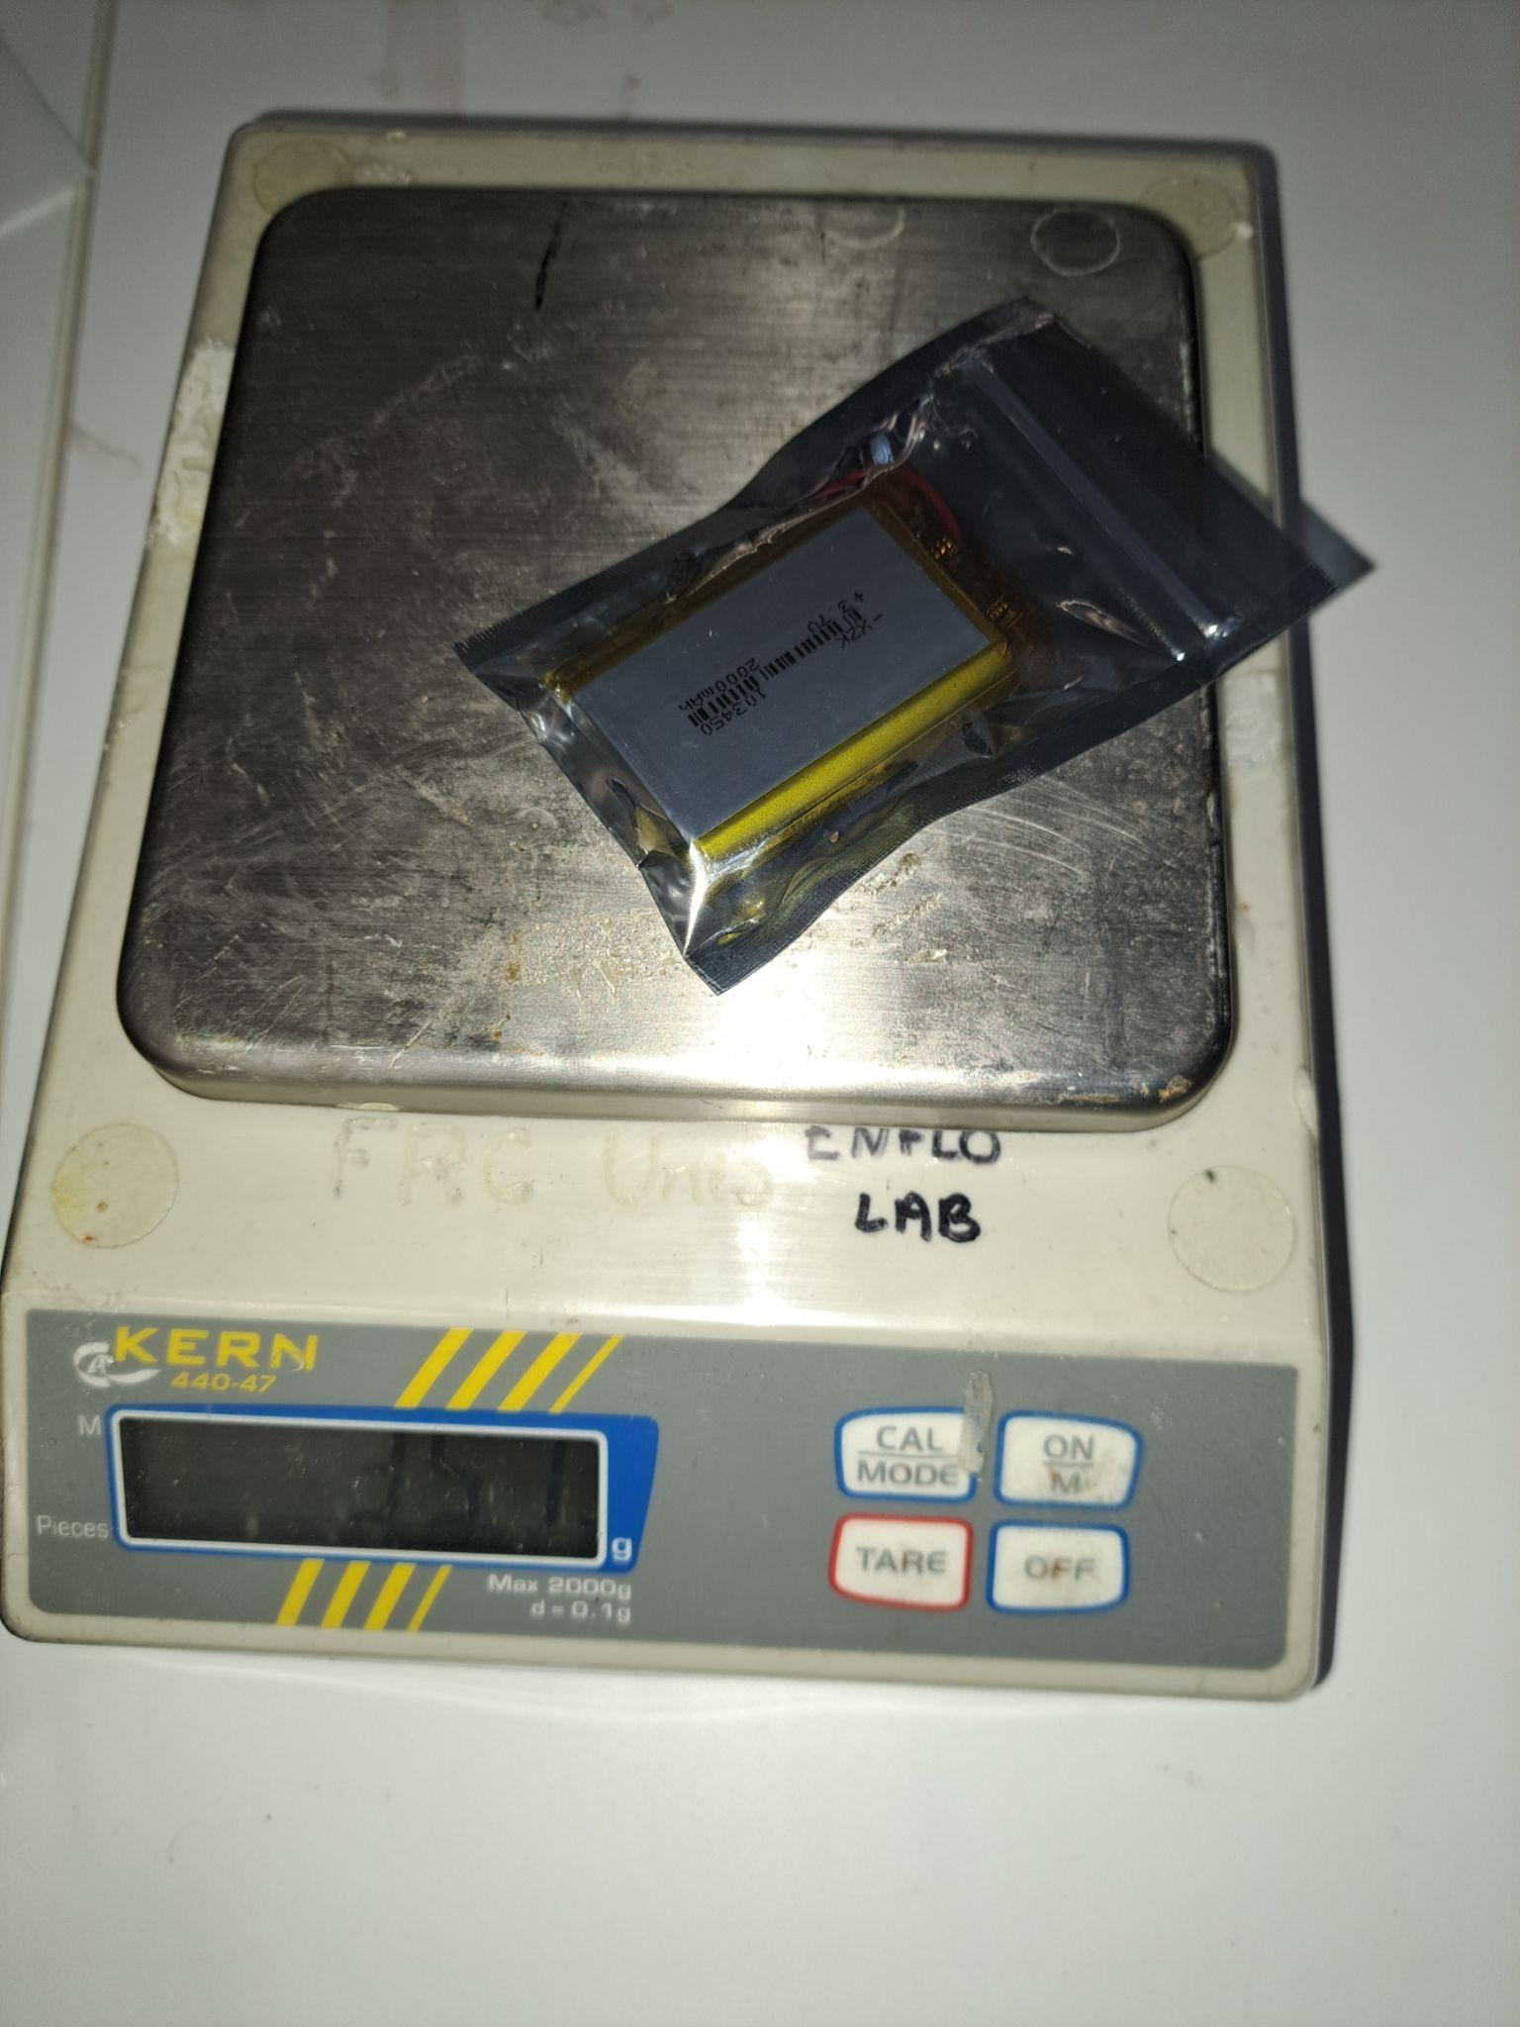
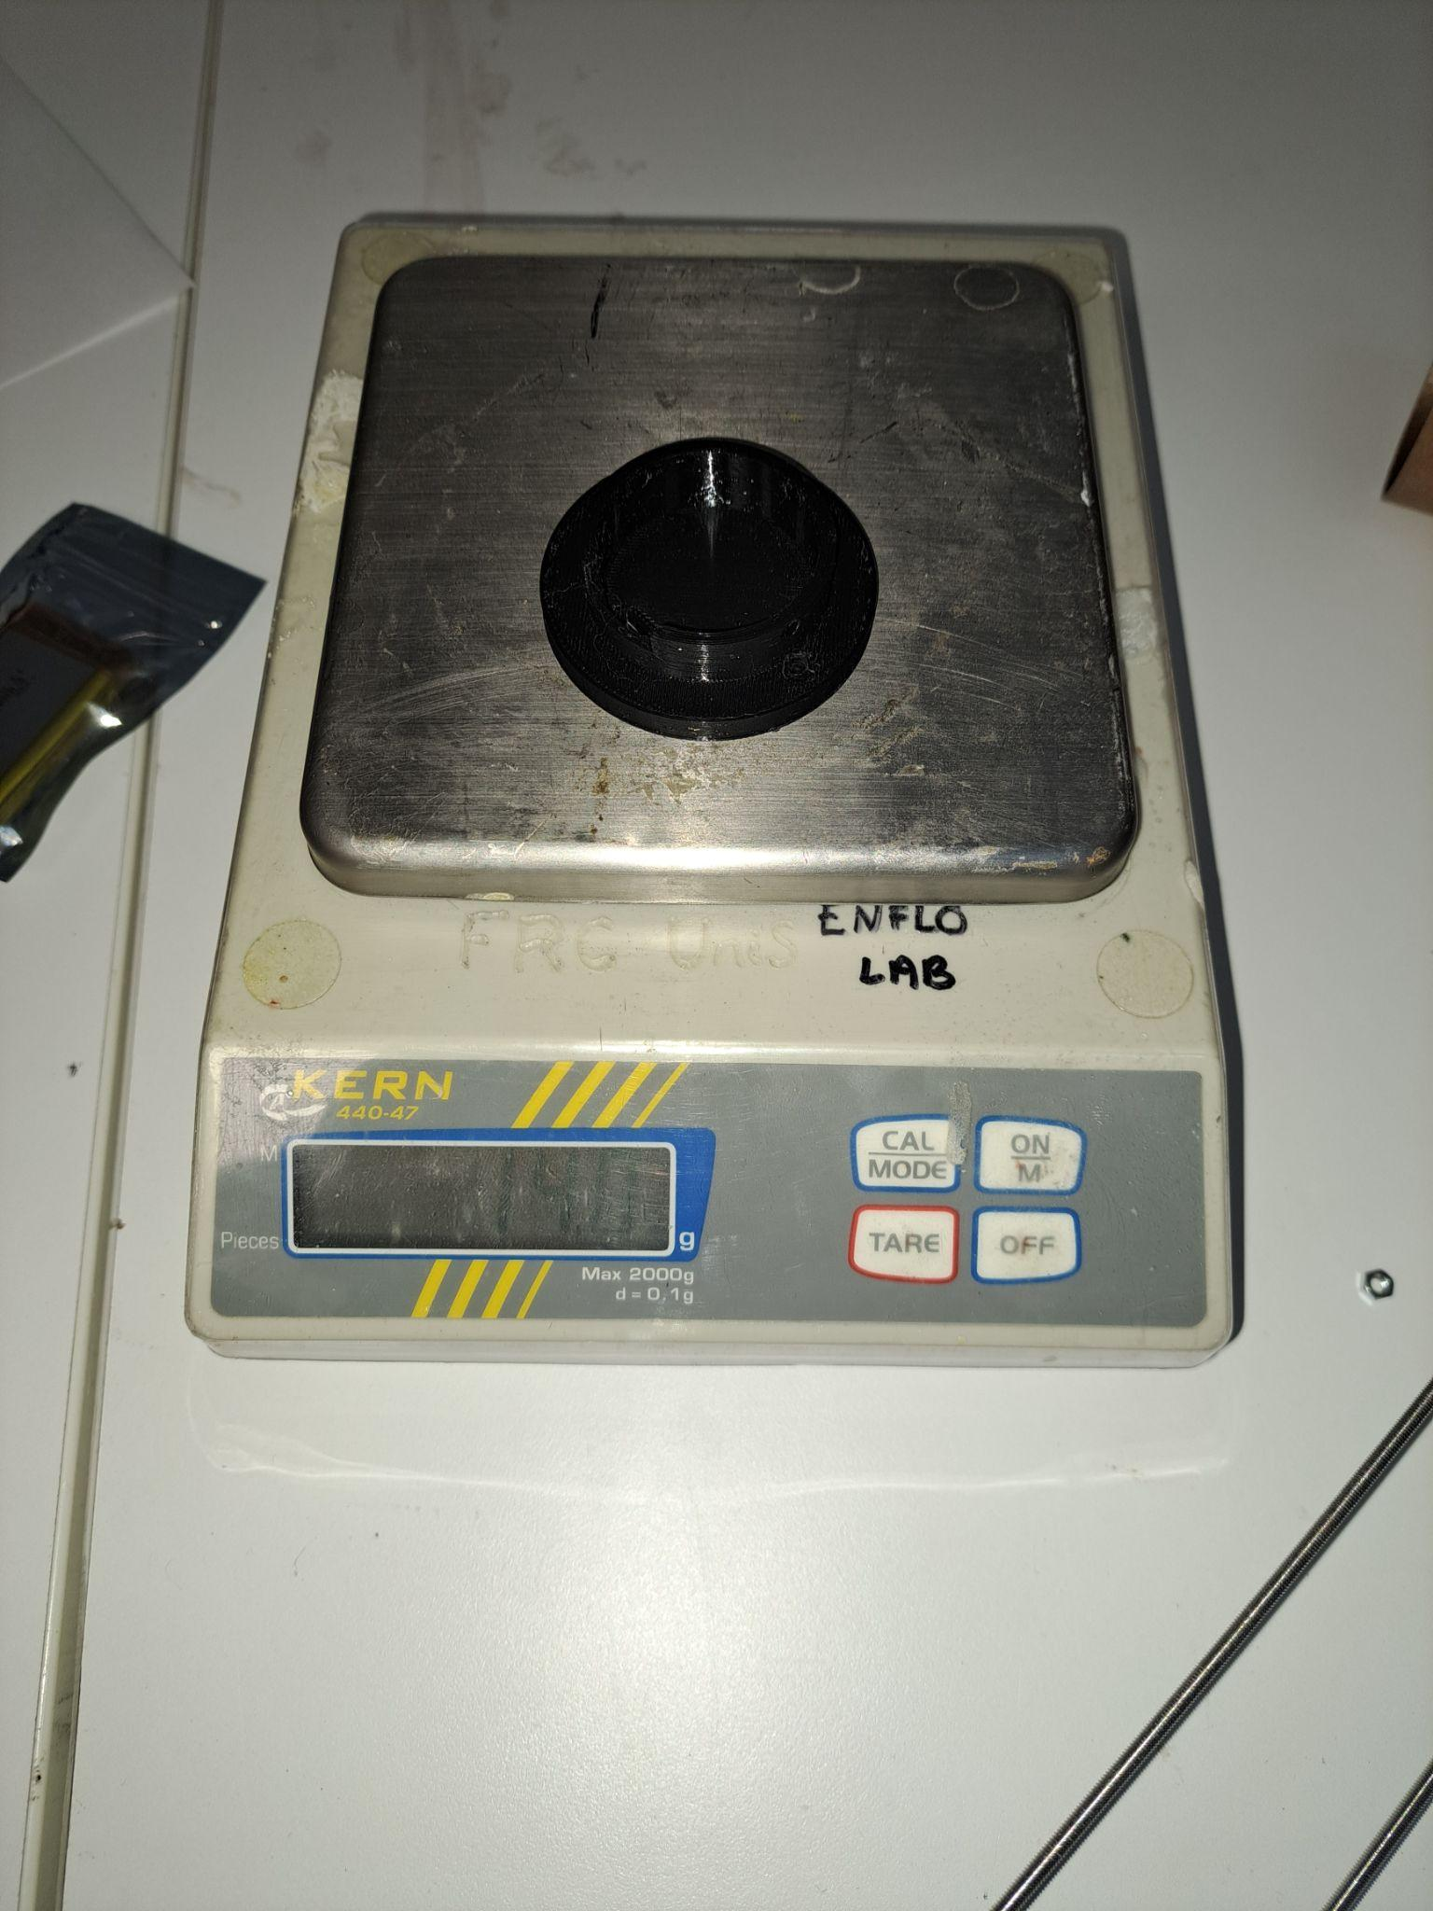
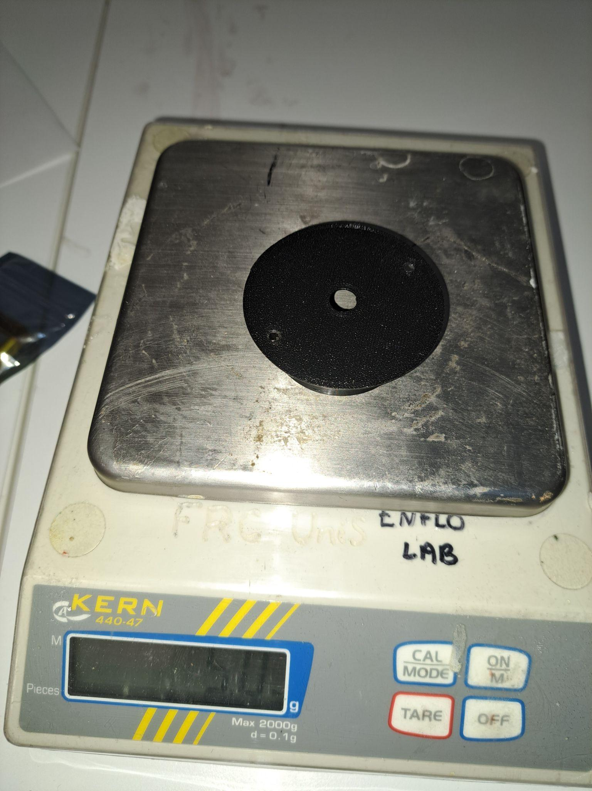
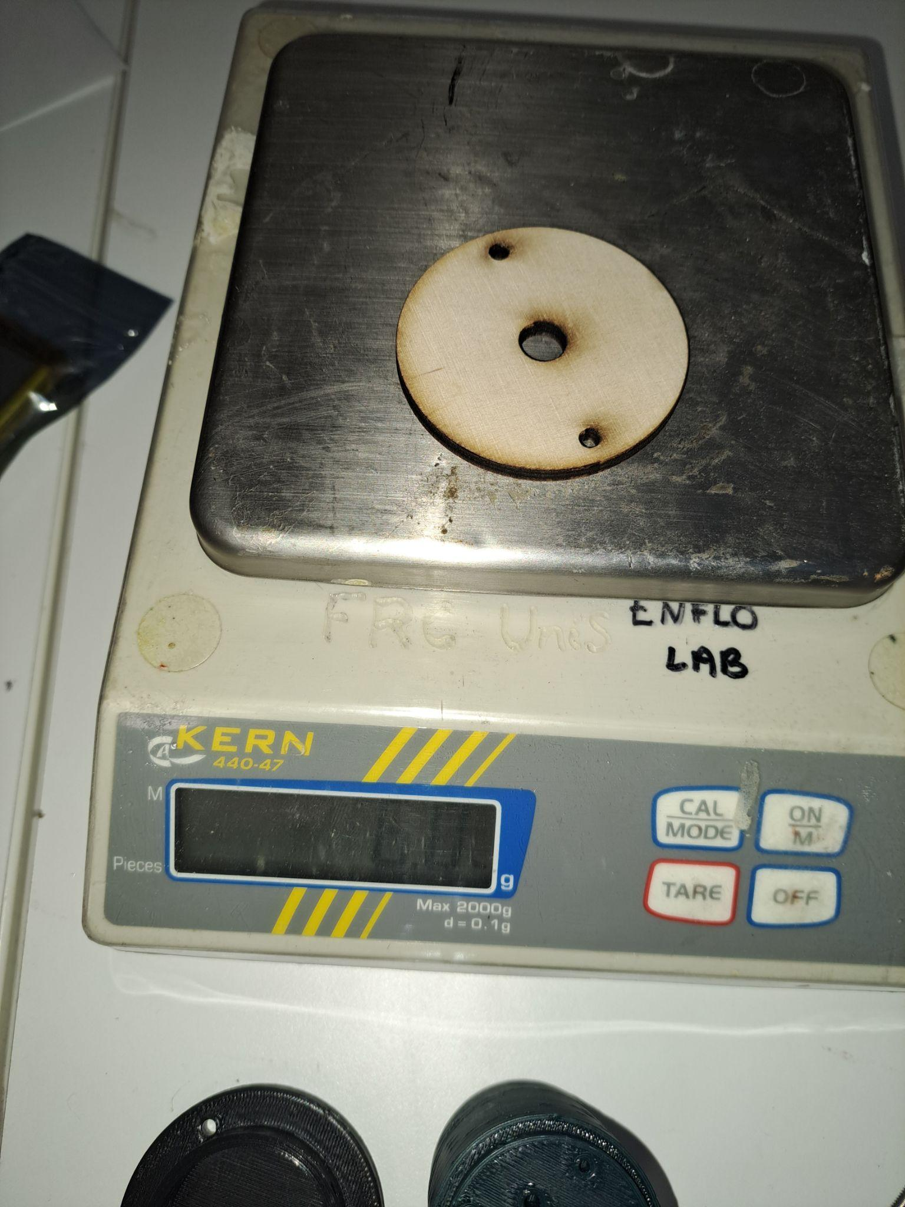
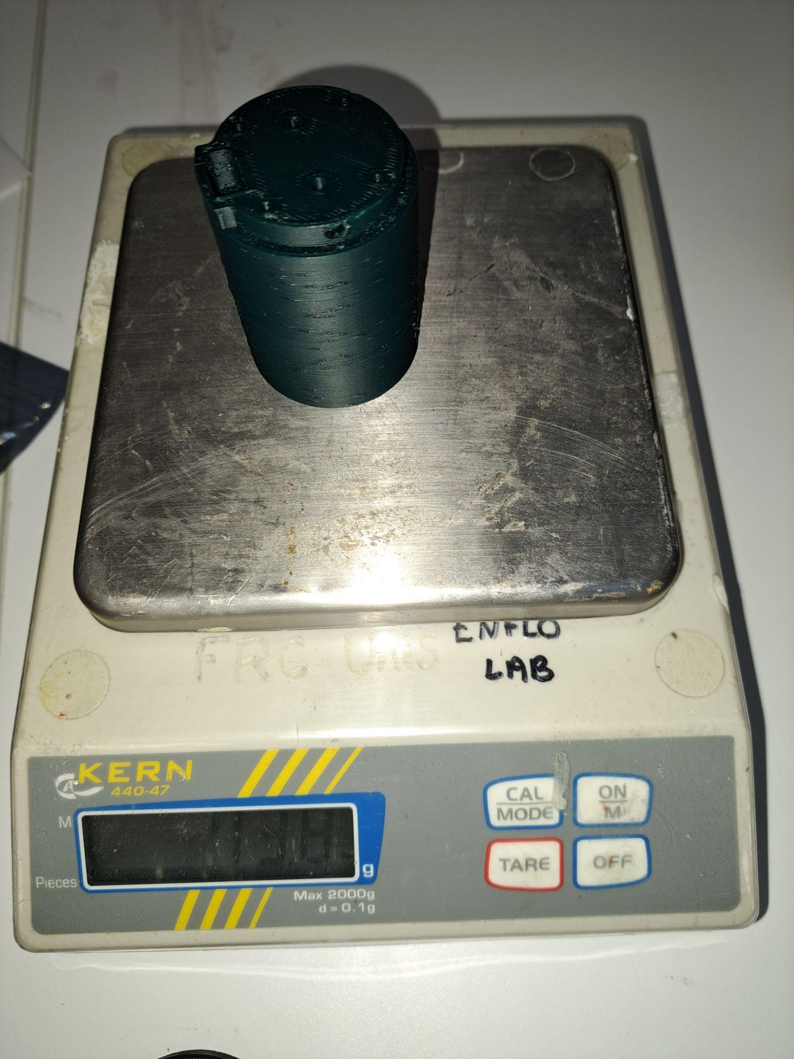
OpenRocket Simulation - mass verification

Slide 24
OpenRocket Simulation - mass verification

Slide 25
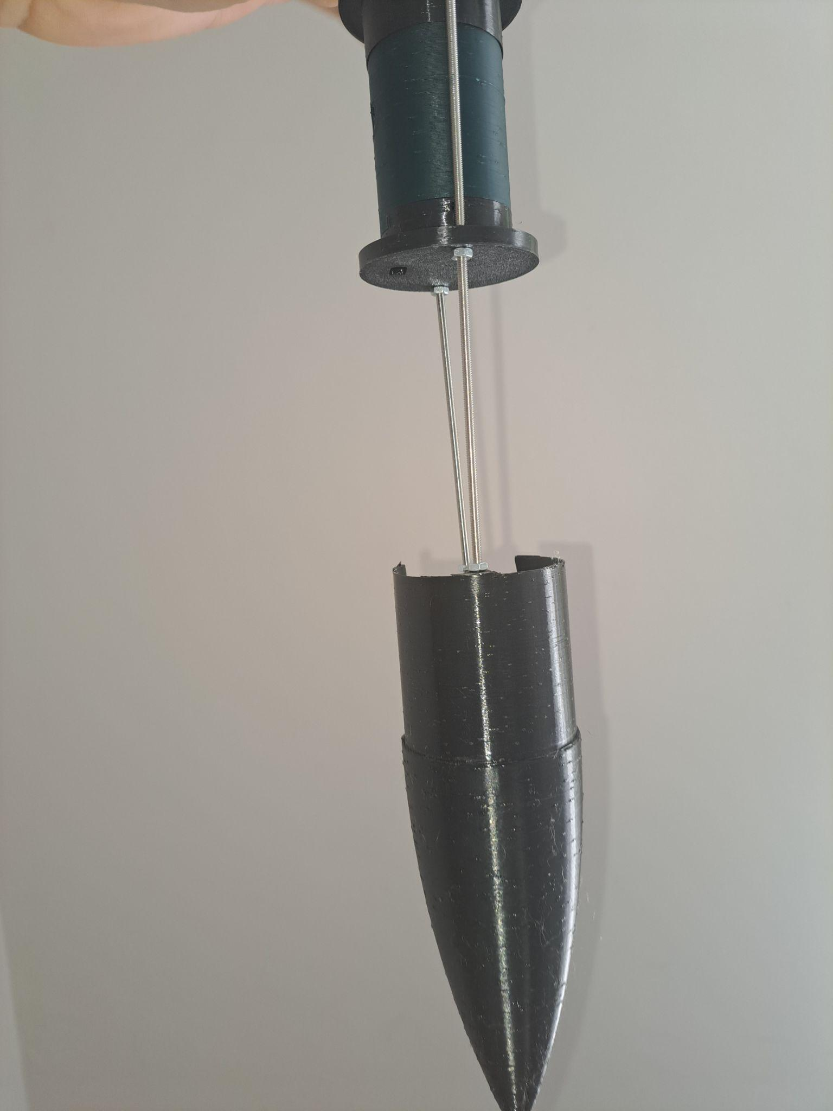
Recovery System Assembly
No Extra Black Powder required.
Demonstration that nothing will fall off the rocket. (Upper Section was inverted, Nosecone did not fall due to gravity as it is supported by two threaded rod.)
Note the damaged section behind, in the image is due to improper use of power tools while removing it for testing . A new nose cone will be printed for launch day.

Slide 26
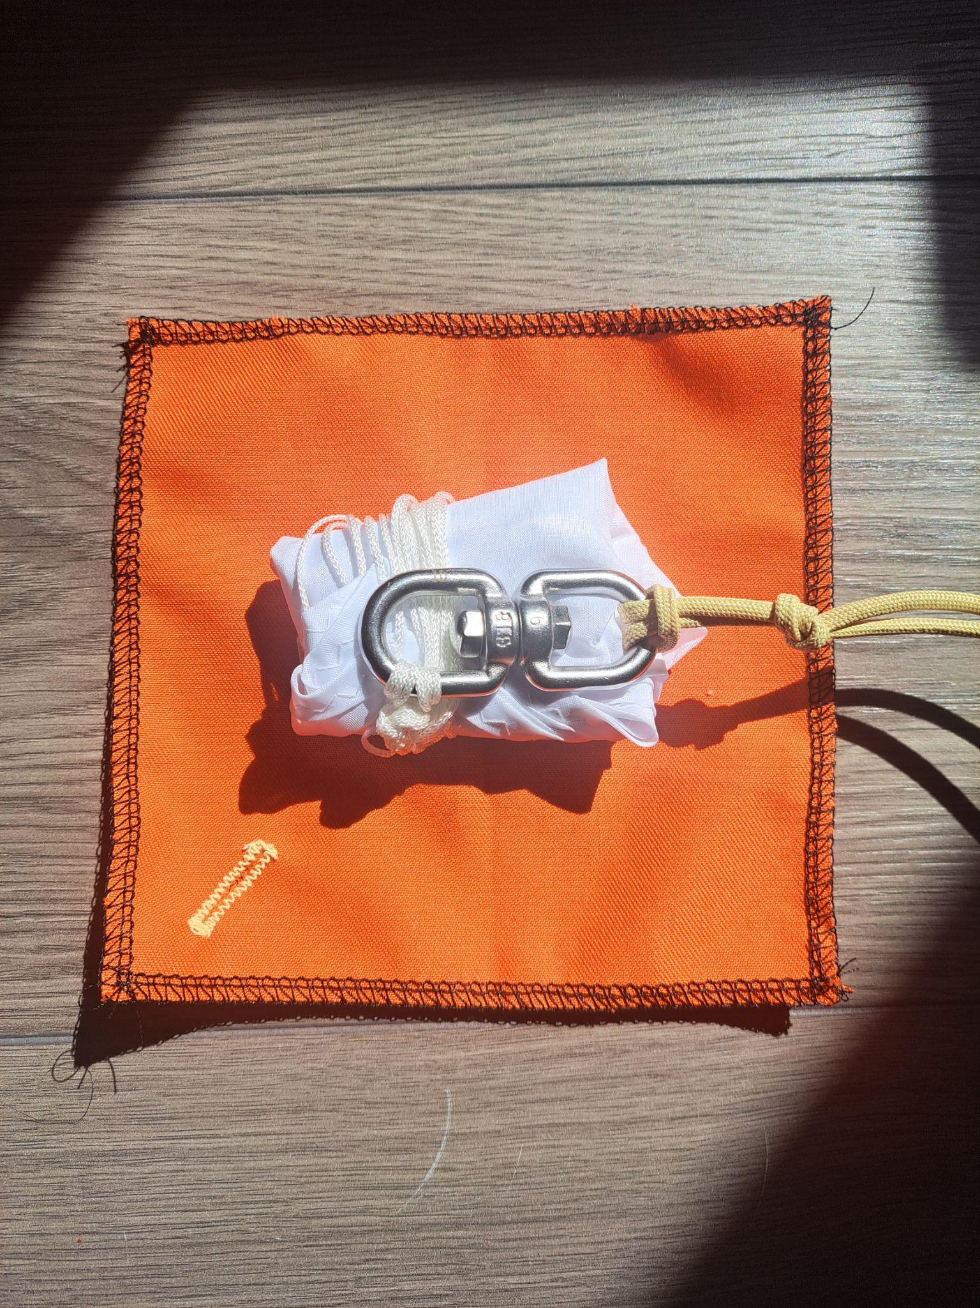
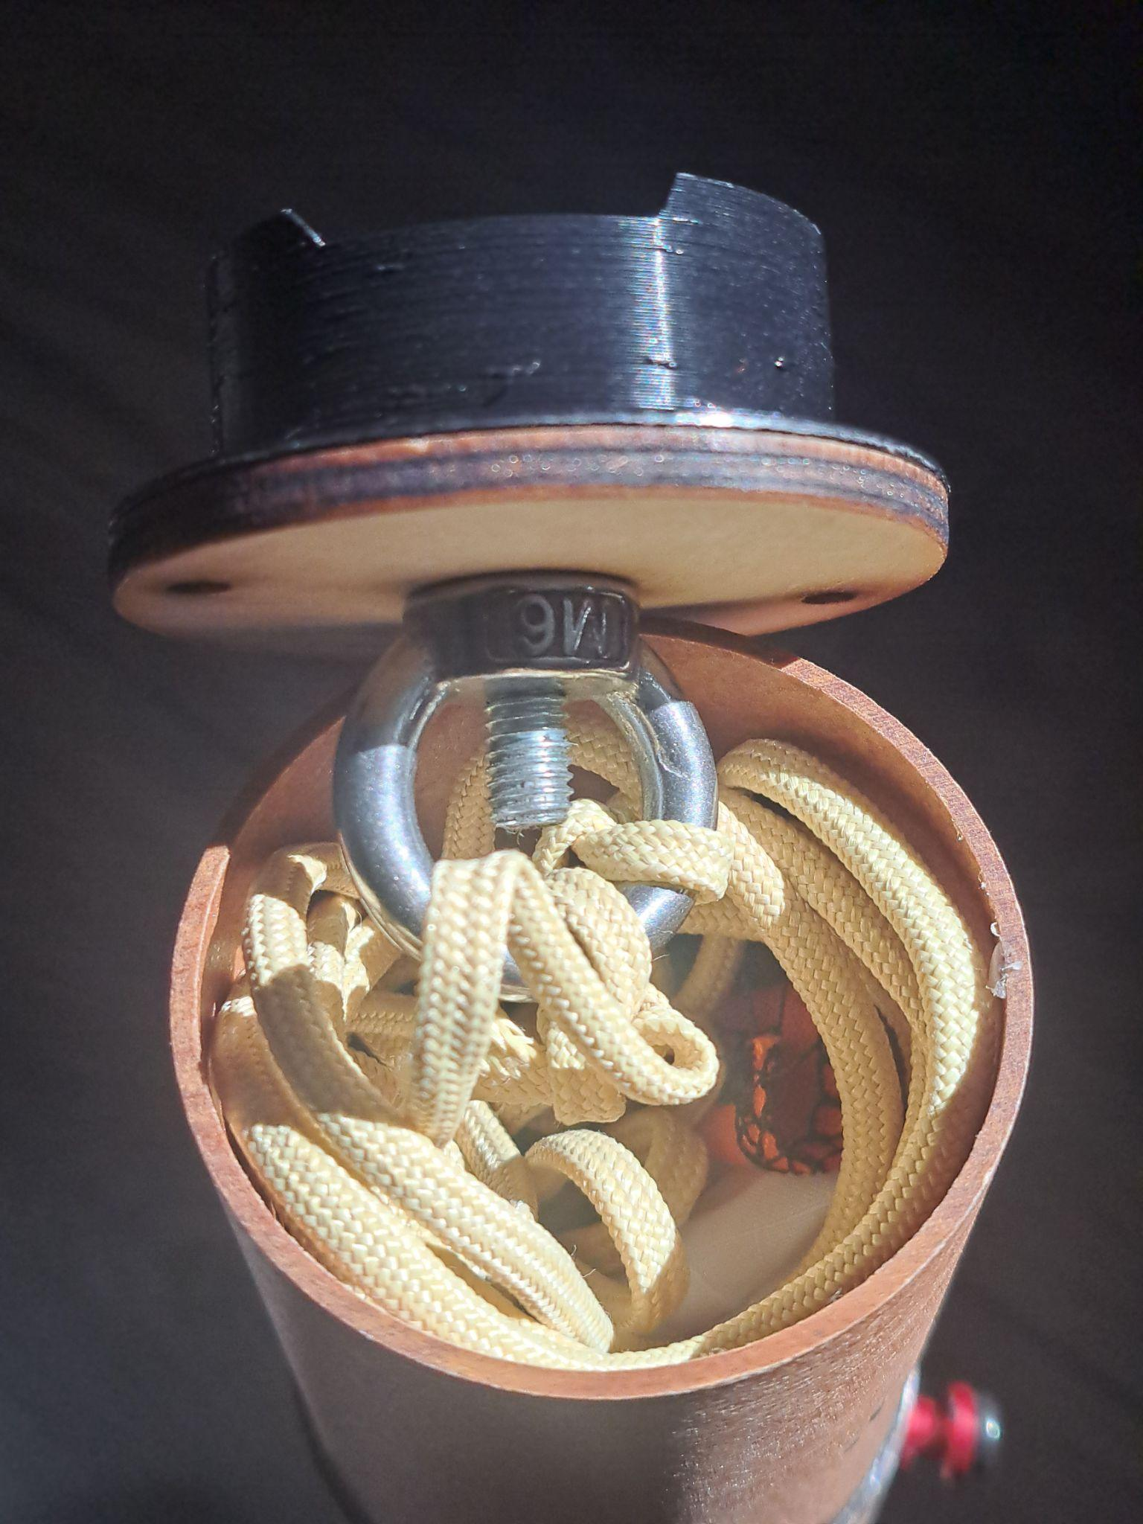
Recovery System Assembly
Examples of what to include:
Recovery occurs 9s after firing, using motor’s ejection charge.
Parachute and blast shields

Slide 27
Recovery System Demonstration

Slide 28
Structural Tests
Examples of what to include:
Evidence of the complete launch vehicle passing all of the structural tests in the technical guidelines
Pictures and videos required

Slide 29
Rideshare Payload Manufacture
Examples of what to include:
Evidence of fully manufactured rideshare payload
Pictures expected
Picture of rideshare payload on scales showing its mass meets NRC MRD-MIS-007

Slide 30
Rideshare Payload Code
Examples of what to include:
Evidence of rideshare payload code developed
Video of code uploaded and functioning as intended
Evidence of how you shall meet NRC MRD-RPD-004 and NRC MRD-RPD-006
One of the biggest hold ups on the launch day from experience will be teams coding last minute. All teams are expected to turn up with their code already developed and should not count on there being sufficient back up slots if they are not ready for their slot

Slide 31
The Customer’s Payload
Examples of what to include:
A video showing the full process of integrating a dummy 3d printed Customer’s payload in your rocket
Evidence that the Customer’s payload will not be damaged by ejection charges or anything similar eg. images/diagrams of protective bulkheads

Slide 32
Competition Day Procedure
Examples of what to include:
A step by step procedure for your team to follow on the competition day. We highly recommend that you practise this in advance to check for tools and parts that you will need
Include a packing list
An example set of sections is:
Day before launch
Morning of launch
At the launch site
After launch
Print this out and bring it with you on the day to tick off!

Slide 33
Any other relevant flight critical tasks
Examples of what to include:
Evidence of completing anything else that would prevent your team from launching if your launch slot was tomorrow

Slide 34
End Slide

